Slide 1
MODULE 1
What is street culture and how does it relate to opportunities for entrepreneurship?
This project has been funded with support from the European Commission. The author is solely responsible for this publication (communication) and the Commission accepts no responsibility for any use may be made of the information contained therein. In compliance of the new GDPR framework, please note that the Partnership will only process your personal data in the sole interest and purpose of the project and without any prejudice to your rights.

Slide 2
Definition
& Theory
for MODULE 1 Introduction
What is street culture and how does it relate to opportunities for entrepreneurship?

Slide 3
Street Culture
is inherently relevant with Inclusion
Photo by Guillaume Issaly on Unsplash
Definition
According to Ilan, street culture shares much in common with mainstream culture, except the former “entails attempting to flourish within a lifeworld that is distinctly subordinate to the life- world of the included” and differs in the “status of participants and the opportunities and strate- gies available to them”.
Jonathan Ilan, Understanding Street Culture,
p. 35
Street art portrays a rebellious spirit, feeding on conflicts of political, eco- nomic and social nature.

Slide 4
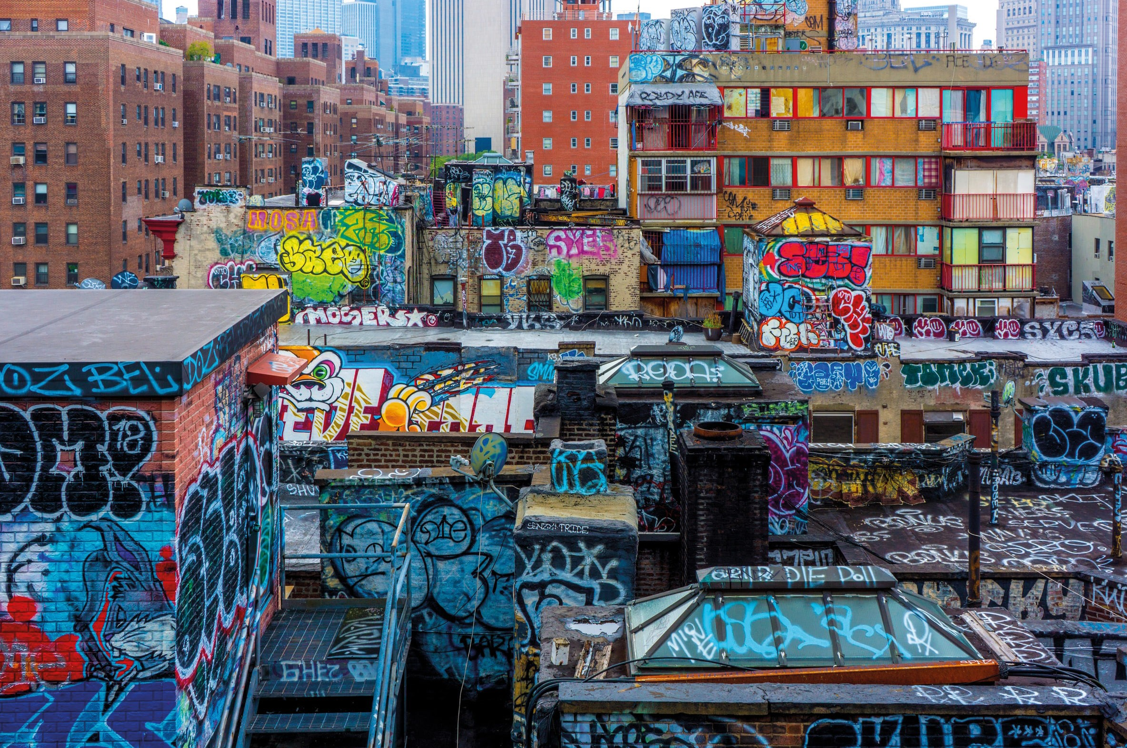
Street Culture
Photo by Cem Ersozlu on Unsplash
Definition
the creative force of the city
Popular styles of urban centres. This is a view of the streets as shared spaces, made for the benefit of all that use them. Street culture thrives in urban centres and big cities. These are the places street culture is born and from there it spreads. It is modern, always pushing the limits of any set idea whether that is fashion, art, design, music or sport. It is the creative forces in the city.
www.urbandictionary.com

Slide 5
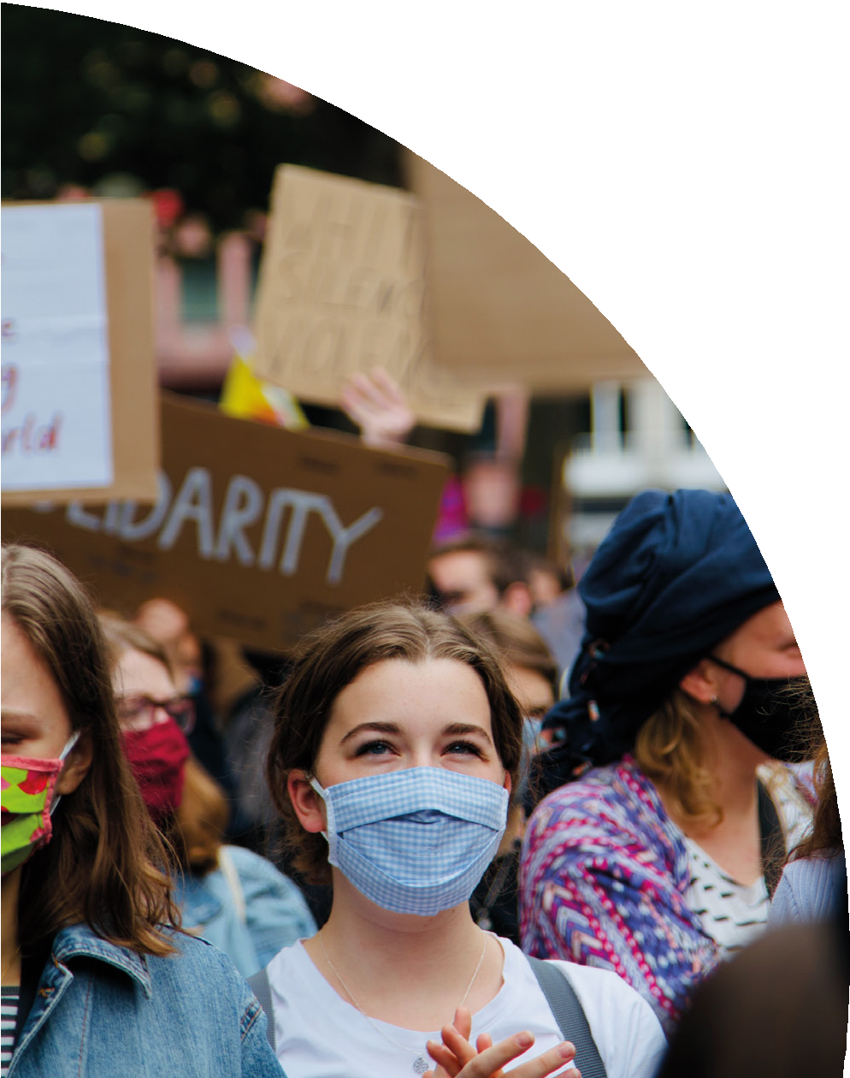
Street Culture
Photo by Malu Laker on Unsplash
a matter of identity
Street Culture is the celebration of community, creativity, inde- pendence, and accomplishment.
Street culture is connected to the identi- ty of a subculture – as it is expressed at the very least through art, community, fashion, language, music, sports, etc.
“Everybody has their own platform to portray street culture; The common ground is that they share the same values: originality, creativ- ity, diversity, and flexibility”.
Zaliwa Musaba, https://odyssey.an- tiochsb.edu/features/sb-local/street-cul- ture-an-emerging-movement/

Slide 6
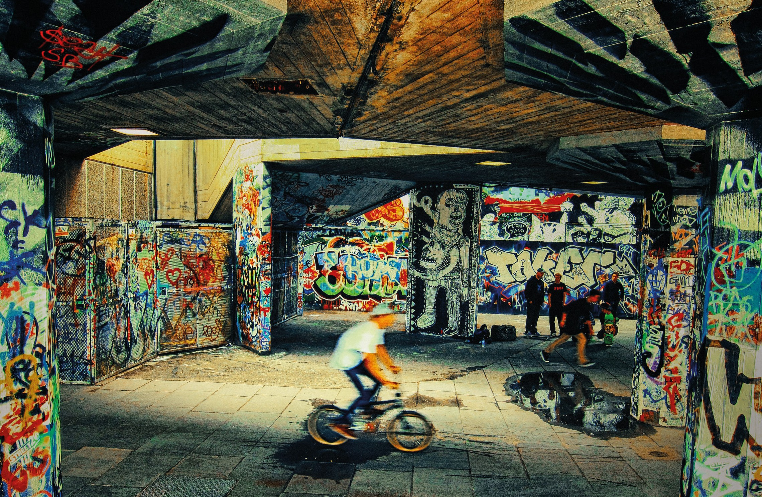
Culture’s Urbanization
Photo by Rohan Reddy on Unsplash
When talking about street culture, things like urbanization and urban culture comes to mind: “fast pace, limited space, multicul- tural dynamics in the developed world as well as multi-class dynamics on a global scale”.
Zaliwa Musaba, https://odyssey.an- tiochsb.edu/features/sb-local/street-cul- ture-an-emerging-movement/

Slide 7
Learning outcome
MODULE 1 aims to offer you a glimpse of the ever-changing currents of street culture that emanate from the head- waters of big cities, yet assume a life of their own through the cultural terrain of each particular country.
We have gathered a selection of sources reflecting on the continuing phenomenon that is street culture, and its relation with entrepreneurship.
Completing this module...
will help you understand the power of culture and creative in- dustries to address the social needs of city dwellers and empow- er them to unlock opportunities for local economic development.

Slide 8
This set of modules allows you to develop the business/entrepreneurial skills and attributes to commercialise on your creative practices and/or knowledge on street culture.
The resources mentioned give you a theoretical and practical understanding of cultural and creative industries and the development of a cultural economy to create your own creative initiatives.
Our collective approach is to integrate entrepreneurship within creative practices relevant to street culture and to take a ‘creative’ approach to the devel- opment of new businesses and the infra- structure that supports them.

Slide 9
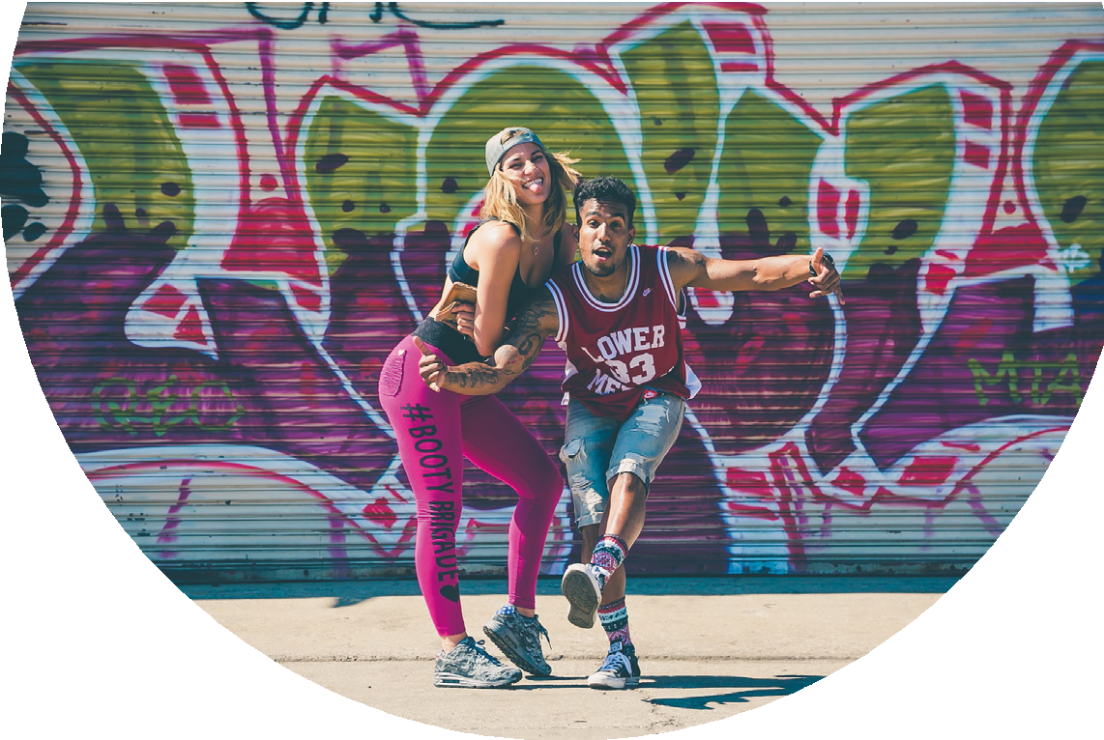
Street Culture
entrepreneurship for youth
This set of modules generates few training resources valuable for their potential to develop skills for people excluded from formal or profession- al education.
Photo by Jakob Owens on Unsplash
In France, Poland, Portugal, Ireland, the United Kingdom and Greece, artists, associations, festivals, public institutions and private structures are working with passion and in- venting new ways of working with very different audiences, with a focus on economic and social inclu- sion.
Street Culture
now integrated in city policies
Originally marginal and clandestine, street culture is now recognized, and has been integrated into the main- stream market, as well as in city poli- cies and governmental planning.

Slide 10
Giving New Life to Urban Spaces
Street culture encompasses many prac- tices: street art, street sports, skate- boarding, rollerblading, music, design, urban planning, architecture, fashion, cooking... By becoming a place of multi- ple creations, the street becomes a possible space for social inclusion, training, work, urban development and tourist attraction.
Street culture embodies an ambition to give a new form and a new life to urban space, while establishing a desire to create links between inhabi- tants that can boost the attractive- ness of a location.
Excerpt from our SCR Resource Pack
tourism
socialising
social inclusion
training
urban planning
Photo by Grace Madeline on Unsplash

Slide 11
Multimedia Resources
for MODULE 1 Introduction
What is street culture and how does it relate to opportunities for entrepreneurship?

Slide 12
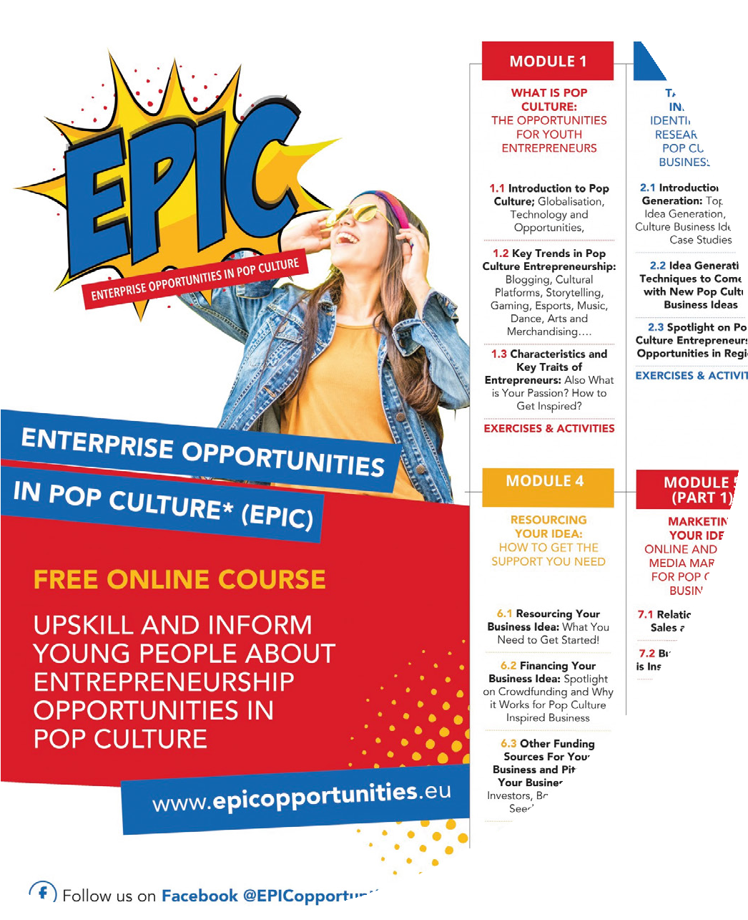
Pop Culture Educational Resources
Multimedia Resources
The EPIC OERs place Pop Culture at the center of an innovative and en- gaging approach to equip young people who are in NEETS (neither in education, training, or employment) with exciting entrepreneurial educa- tion, skills, tools, and support they need to develop a Pop Culture business.
www.epicopportunities.eu/curric- ulum-and-open-educational-re- sources/

Slide 13
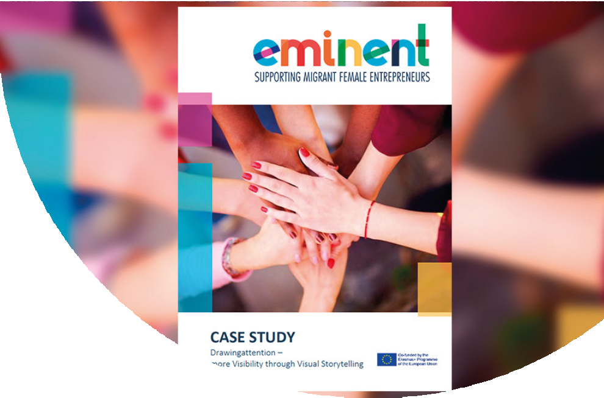
EMINENT Educa- tional Resources
Multimedia Resources
supporting migrant female entrepreneurs
This project aims to facilitate the increase of female migrant entrepreneurs by transforming their access to and the quality of the training they receive from entrepreneurship VET in- stitutions .
This course aims to improve access quality training for entrepreneurship educators within the context of inclusion and diversity, so as to unlock the potential of migrant & refugee women.
https://www.eminentproj- ect.eu/course-curricu-
lum-and-class- room-materials/

Slide 14
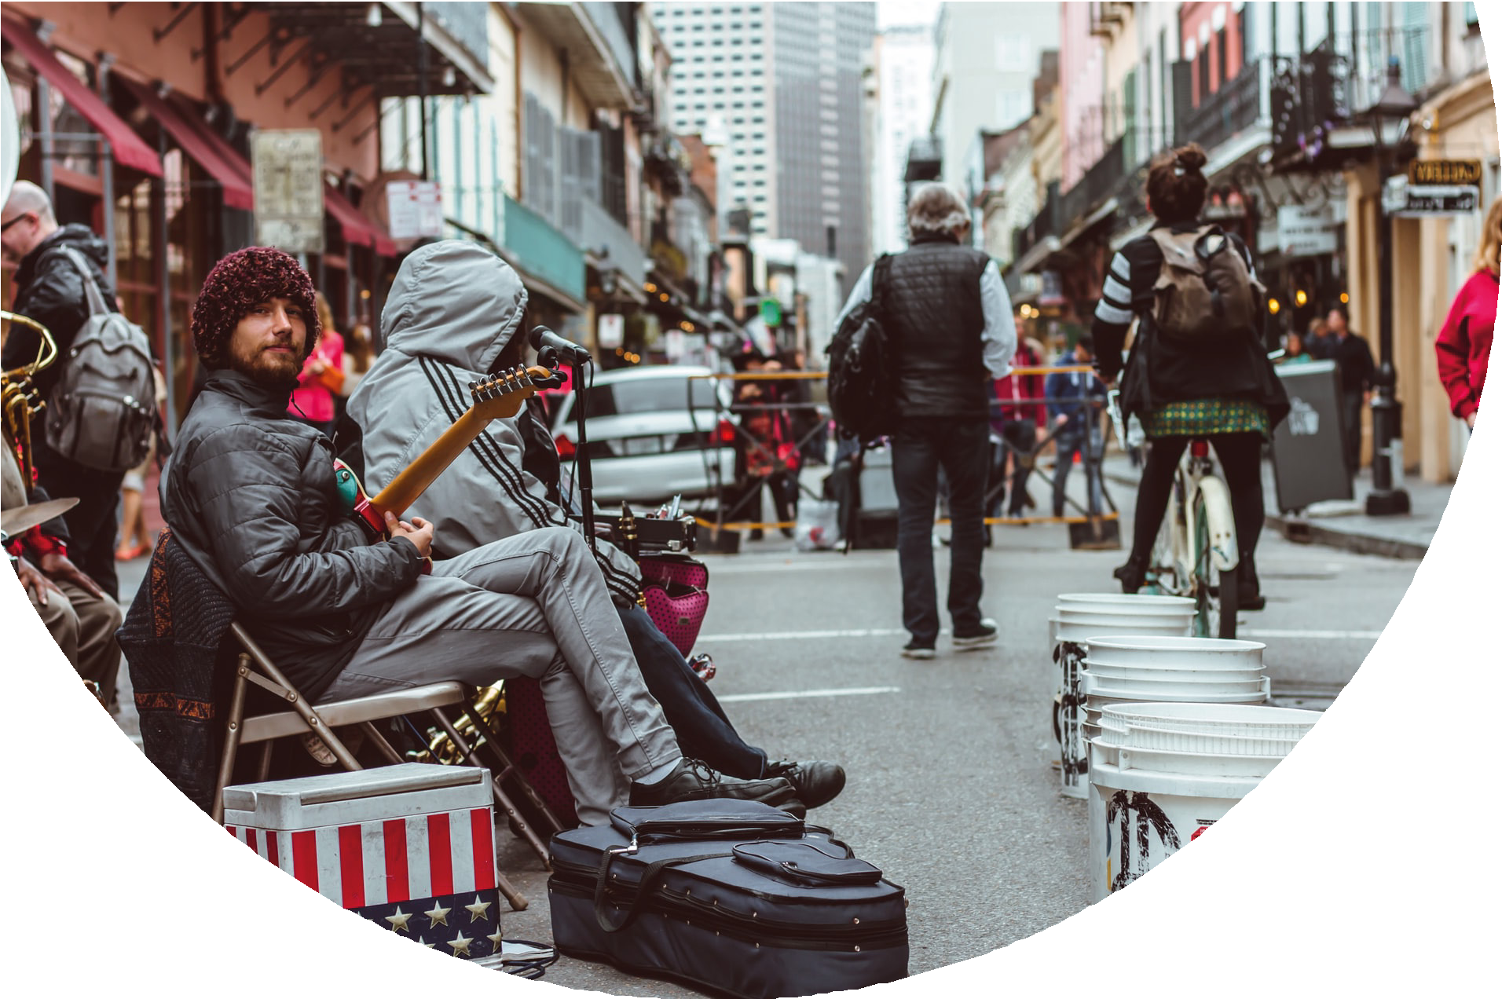
Multimedia Resources
The Street Music Business Research
This in-depth research presents consumer responses to buskers performing on the street and on online video platforms.
https://link.springer.com/article/10.1007/s11002-021-09566-8
Photo by Matthew Lejune on Unsplash

Slide 15
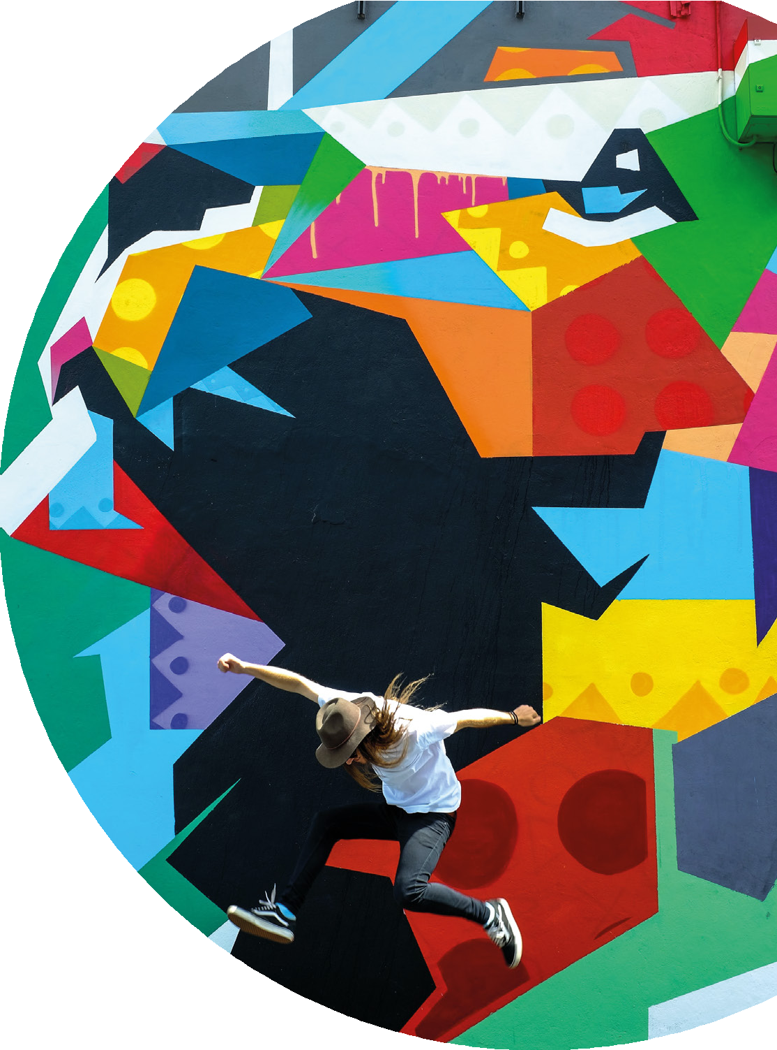
Boosting Creative Entrepreneurship through creative-based urban strategies
Multimedia Resources
Photo by Quaid Lagan on Unsplash
A study and plan on...
Connecting urban strategies with creative and cultural industries.
Facilitating the “creative ecosys- tem” to be able to attract (more) creative entrepreneurs and boost cre- ative entrepreneurship in dedicated urban areas.
https://urbact.eu/sites/default/files/creative_spirits_state_of_the_art.pdf

Slide 16
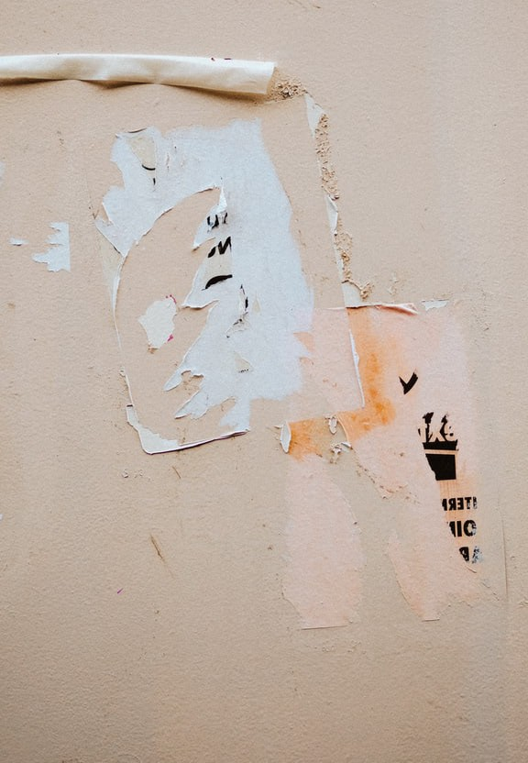
A Street Art Guide
Multimedia Resources
of Warsaw murals
An example of a street art guide for Warsaw visual street art, especially devoted to tourists.
www.culturaobscura.com/street-art-warsaw

Slide 17
Case Studies
for MODULE 1 Introduction
What is street culture and how does it relate to opportunities for entrepreneurship?

Slide 18
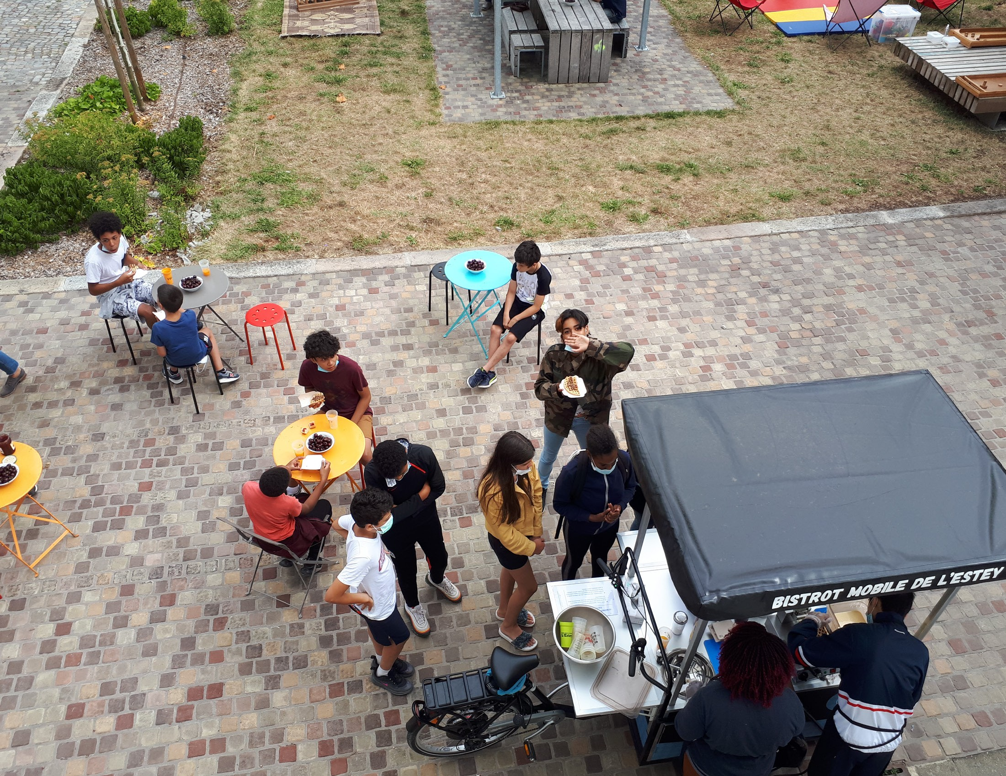
BISTROT MOBILE DE
L’ ESTEY
Case Study
A creation of the L'Estey social centre in the city of Bègles, offers mobile street food out- lets in several neighbourhoods with an original menu of breads from around the world: Italian Piadina, Indian Naan, Moroccan Batbout, crepes and waffles.
www.mairie-begles.fr/centre-so- cial-et-culturel-de-lestey/
Young people aged between 15 and 19, from marginalized districts, are in charge of making, preparing and distributing the food with a specially equipped bicycle.

Slide 19
BISTROT MOBILE DE L’ ESTEY
Case Study
Why it is innovative...
Working in pairs with a volunteer and accompanied by a cook, these young people discover, thanks to this project, the catering trade and a different relationship with the inhabitants of the neighbourhoods.
They are recruited in collaboration with the city's various social orga- nizations, for one week sessions, during which they are paid.
The mobile bistro is also part of a zero waste approach that the team introduces to young people.

Slide 20
BISTROT MOBILE
DE L’ ESTEY
cont. Case Study
Why it is innovative...
The bistro is an outdoor meet- ing place with international street food and encourages young people to talk and feel comfortable in con- tact with the inhabitants.
Some of them go on to training in the restaurant business, because for the project leaders, cooking is a real lever for integration.

Slide 21
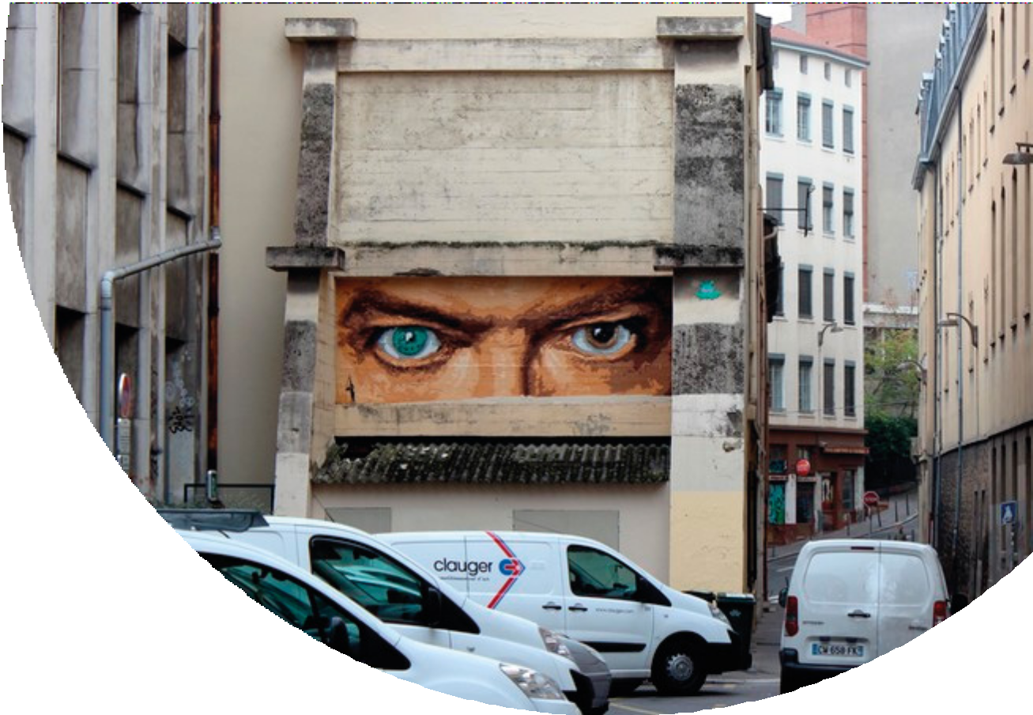
Case Study
BIG BEN (France)
BIG BEN (France) started working clandestinely in the streets of Lyon at the age of 40, in 2009, in order to share a political vision of the world because his hopes for change were not coming. Influenced by Bansky and Blek le rat, this self-taught artist claims to make street art to, amongst other things, fight against advertising.
www.bigbenstreetart.com

Slide 22
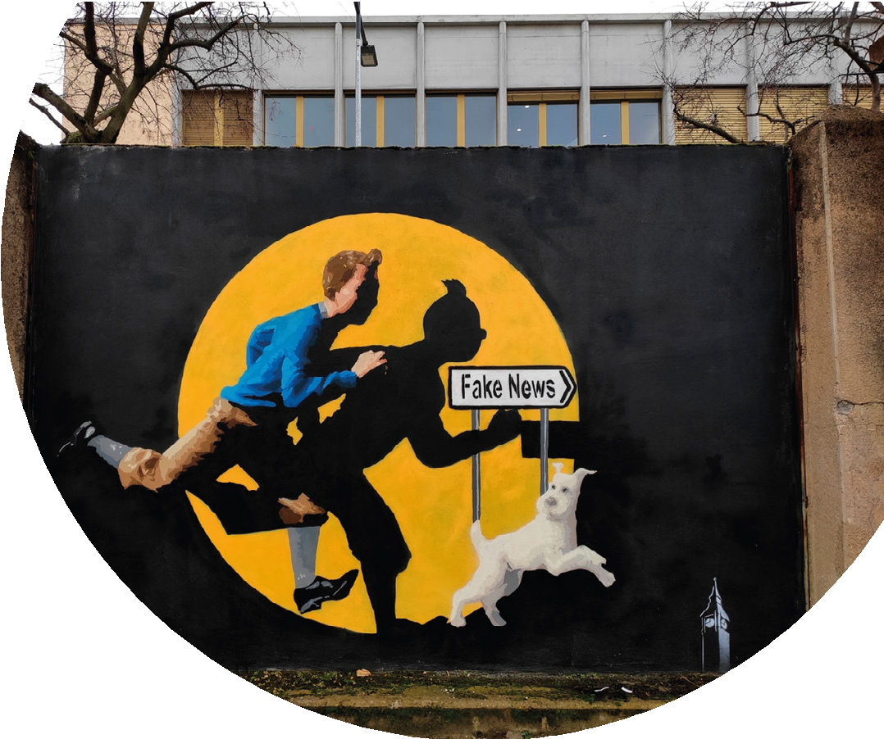
The case study of BIG BEN
Walls totally free
cont. Case Study
from advertising & political agen das
The street is a place of expression where he shares his moods, without making concessions, and he advocates for every city to have walls of expression that are truly free, not just tolerated or framed by urban projects.
According to him, street art has not a decorative vocation but a much more profound role, like any artistic discipline. Big Ben is convinced that art can help people think and feel better.

Slide 23
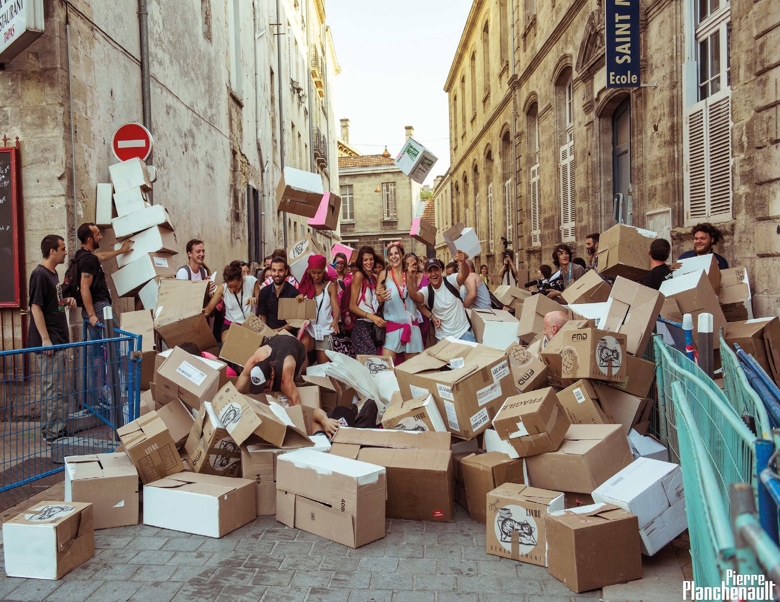
FESTIVAL CHAHUTS
Case Study
FESTIVAL CHAHUTS was born in 1992 in a district of Bor- deaux that suffered from a negative external image.
The local cultural and social associations wanted to create an event that would make the in- habitants proud and change the perception of the area for the other inhabitants of the city.
The hoped-for impact was also to develop an openness to the world, and to enable indi- vidual and collective emancipa- tion.
www.chahuts.net

Slide 24
cont. Case Study
The ethical position of the festi- val is to include everyone. The festival is also an opportunity to highlight all year long project , called “Chahuts’ Fabriques”. In that occasion, artists benefit from immersive residencies to get to know and exchange with the inhabitants and the neigh- bourhood and to find out what the people want.
FESTIVAL CHAHUTS
Storytelling was the first axis of the festival, which gradually expand- ed to include the arts of speech with street artists, comedians, performers, street artists...
For Chahuts, the art of speech means, at the edge of the cultural and social fields, the art of circulating speech, the art of listening to it, of
highlighting it or analysing it.
In thirty years, the image of this district of Bordeaux has changed positively and Chahuts is one of
the historical actors.

Slide 25
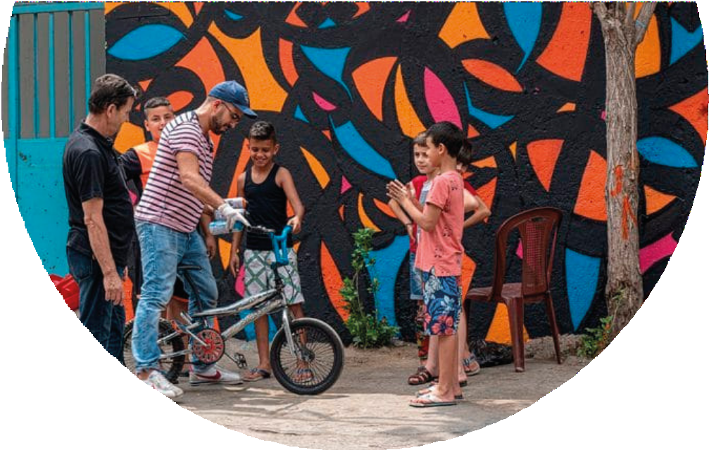
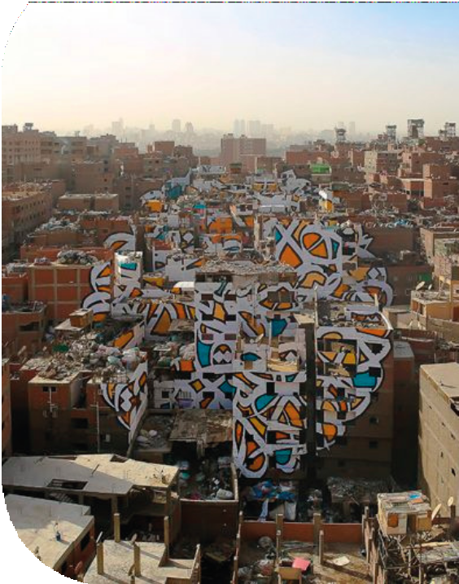
Case Study 3
Ted Talk
for Street Art
Artist using calligraphy and grafitti in urban walls to send message of hope and peace.
French-Tunisian artist eL Seed blends the historic art of Arabic calligraphy with graffti to portray messages of beauty, poetry and peace across
all continents.
www.ted.com/talks/el_- seed_street_art_with_a_mes- sage_of_hope_and_peace

Slide 26
Learning Activities
for MODULE 1 Introduction
What is street culture and how does it relate to opportunities for entrepreneurship?
Photo by Jason Goodman on Unsplash

Slide 27
1. Building from clips
Exersices
3. Wikipedia Note
Participants are asked to create a note about themselves, this note can later be added to Wikipedia. In this exercise participants need to create autobiographical page, that is also written in innovative way.
Participants should use the clips from newspapers to build an advertisement about their dream business. The adver- tisement should be about a business related to street culture. Participants should not write additional words on the clips.
2. Photography
Participants should photograph a places in urban environment, where they would like to start their dream business. Participants can choose the theme of their business, but it should be within street culture sector.

Slide 28
Self - Assessment Exercise
for MODULE 1 Introduction
What is street culture and how does it relate to opportunities for entrepreneurship?

Slide 29
Self Assesment Tool for “wannabe” entrepre- neurs
Self Evaluation
Here you will find an Entrepreneur- ship Assessment used in another ERASMUS+ project which had very good feedback for those deciding to explore Self-Employment.
You can try to fill it and share the results in classroom.
https://thevisionworks.brillian- tassessments.com/Home/Index/?responseCode=MjKtw2bQiY9 x7X2byq2fAeOKA3d%3d

Slide 30
Thank You!
:)

Slide 31
https://www.street-culture.eu
www.facebook.com/streetcultureforregions
@streetcultureforregions
This project has been funded with support from the European Commission. The author is solely responsible for this publication (communication) and the Commission accepts no responsibility for any use may be made of the information contained therein. In compliance of the new GDPR framework, please note that the Partnership will only process your personal data in the sole interest and purpose of the project and without any prejudice to your rights.

