Slide 1
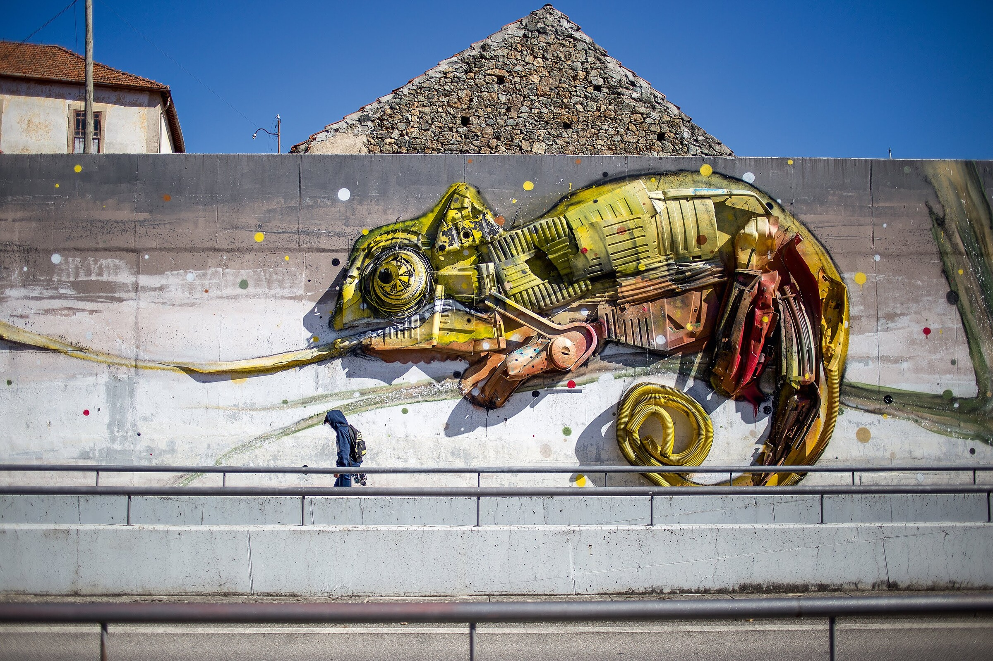
MODULE 5
Marketing your idea on a shoestring: brand development, word of mouth, social media and reputation marketing.
Photo by Câmara Municipal de Bragança
This project has been funded with support from the European Commission. The author is solely responsible for this publication (communication) and the Commission accepts no responsibility for any use may be made of the information contained therein. In compliance of the new GDPR framework, please note that the Partnership will only process your personal data in the sole interest and purpose of the project and without any prejudice to your rights.

Slide 2
Learning outcome
MODULE 5 focuses on the several ways you can communicate your business and the importance of developing your brand right from the start.
We have gathered a selection of sources reflecting on the brand development and social media tools.
Completing this module...
will help you understand the power of a brand and how everything that you do can affect your brand in a positive and in a not so positive way.

Slide 3
Definition
& Theory
for MODULE 5
Marketing your idea on a shoestring: brand development, word of mouth, social media and reputation marketing.

Slide 4
Brand
Photo by Malu Laker on Unsplash
Branding is the process of connecting good strategy with good creativity
A brand is a product or service to which customers have given value and identity. We can try to manage the brand, through design, communication and name, but we are never in full control of the brand image.
“Your brand isn’t what you say it is. It’s what they say it is.”
- MARTY NEUMEIER

Slide 5
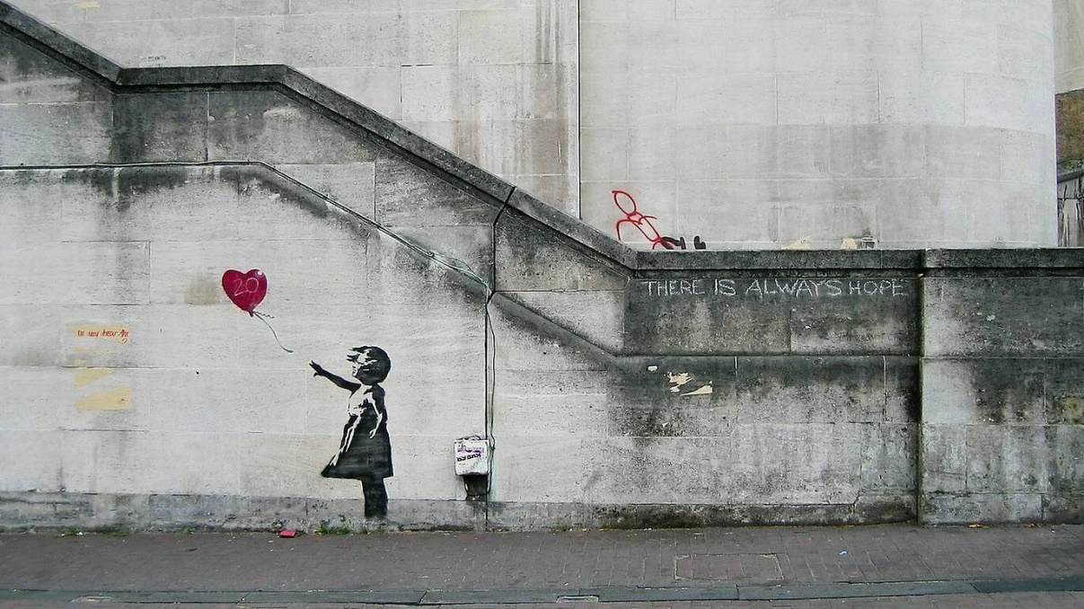
Identity
is…
Unique and non-transferable.
No two brands have the same identity. A product can be copied, but it is impossible to copy the identity.
Coherent
The identity must be directly related to the product and service.
Objective and Adaptable
The identity must be direct in its purposes, the communication adaptable according to the audience and be able to evolve over time.
Photo taken from Observador.pt
Bansky
Has an unique style in his art. You can relate Bansky and his paintings just by seeing them. Banksy is his own identity.
Bansky created an identity that is coherent, unique and objective.

Slide 6
Source: https://www.graphicsprings.com/blog/view/infographic-psychology-behind-colors-1
Design
Colours and formats in logos and communication transpire emotions, sensations and thoughts in your target audience.
Learn more

Slide 7
Social Media
Photo by Cem Ersozlu on Unsplash
Definition
Social Media is a set of online communication channels dedicated to interactions, content sharing and community experiences. It allows you to have a high level of brand authority in the market and success with your customers.

Slide 8
Channels you can use
Social Medias;
Blogs;
Forums;
Websites;
Partner websites;
Email-Marketing;
Social Networks aren’t about websites. They’re about experiences.
Photo by Grace Madeline on Unsplash

Slide 9
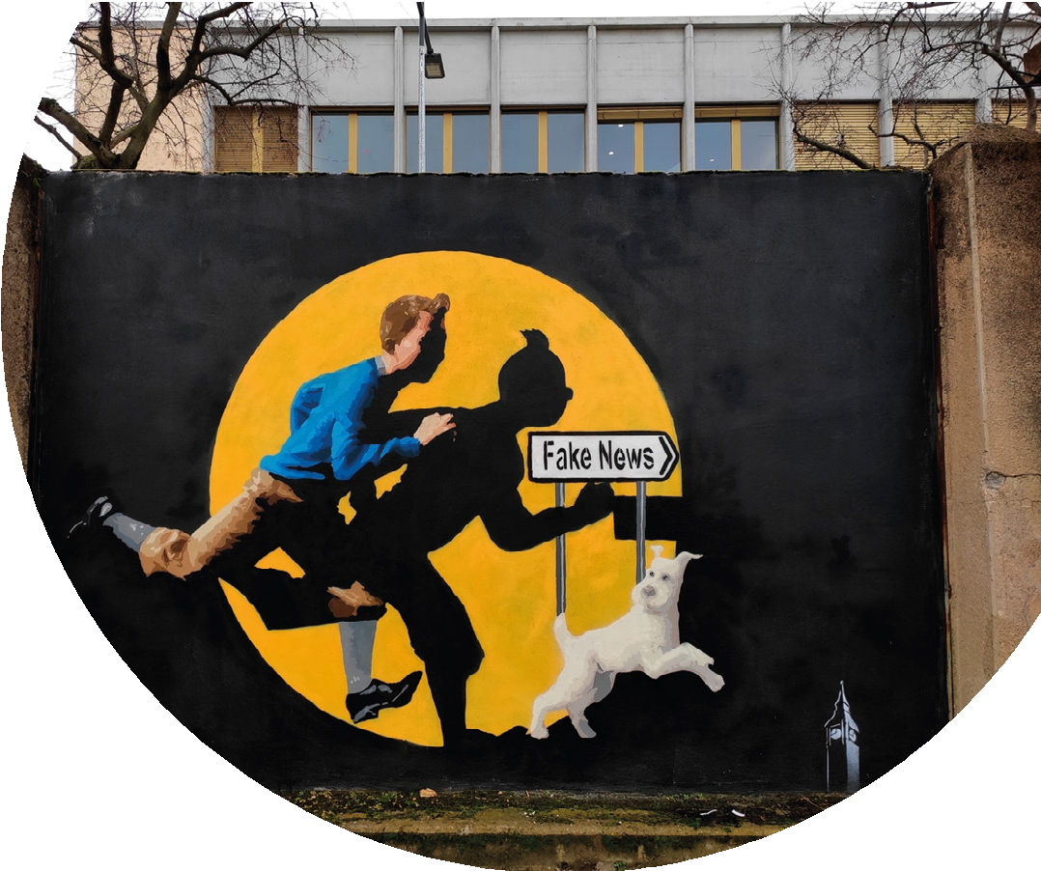
Metrics are key…
Everything on the web can be measured and for an impactful brand visibility you should adapt your strategy based on the data that you gather from the several channels that your brand is using.
Engagement;
Reach;
Rejection Rate;
Clicks;
More: https://blog.hootsuite.com/social-media-metrics/
Social media metrics is the data used to assess the impact of social media activity on marketing campaigns and a company's revenue.

Slide 10
Sales Funnel
Awareness
is when a potential customer learns about your product or service.
interest
is when you have attracted a customer as they search for a solution to their problem.
consideration
is when you have attracted a customer as they search for a solution to their problem.
intent
(aka Desire) is when customers are deciding to buy because you are solving their problem
buy
(aka action) is when customers are making a purchase and you are making a sale. The potential customer has become an actual customer.

Slide 11
Sales Funnel
40%
Awareness
30%
interest
At every stage there is a different percentage of customers available.
40% of the total potential customer base are aware of you.
8% are making a purchase with you.
Where can the business improve?
What improvements may be made?
consideration
28%
10%
intent
8%
buy

Slide 12
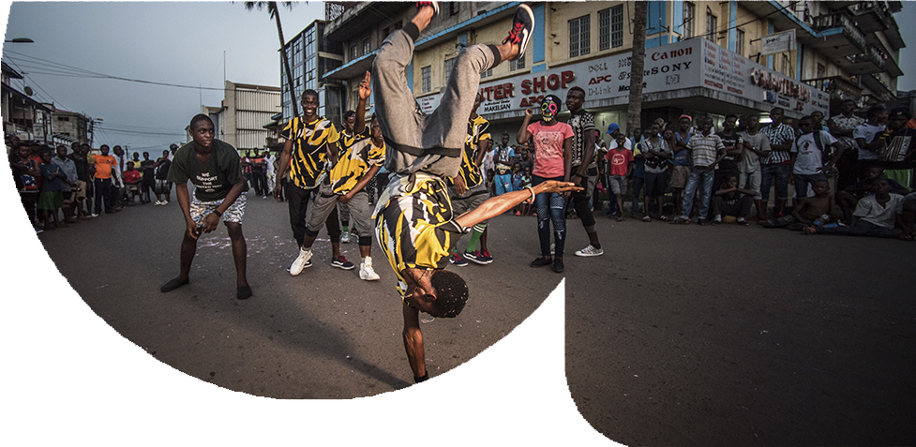
Photo by form PxHere
Word-of-Mouth
Word-of-Mouth is the strongest marketing you can aim to achieve…but beware it can be deadly also.
Word-of-mouth marketing
happens when consumers talk about a company's product or service.
According to Nielsen, 92% of people around the world said they trust recommendations from friends and family (earned media) above all other forms of advertising.
https://www.investopedia.com/terms/w/word-of-mouth-marketing.asp

Slide 13
Multimedia Resources
for MODULE 5
Marketing your idea on a shoestring: brand development, word of mouth, social media and reputation marketing.

Slide 14
Photo by Cem Ersozlu on Unsplash
Multimedia Resources
Exemple of Social Media Tools and Channels:
Source: https://www.epicopportunities.eu/curriculum-and-open-educational-resources/
Email Marketing
Social Media Marketing
Search Engine and App Store Optimization (SEO / ASO)
Display Advertising
Native Advertising
Events & Webinars
A/B Testing & Website Optimization
Content Marketing
Automation
Customer Relationship Management (CRM)
Pay-per-click (PPC) Advertising
Affiliate Marketing

Slide 15
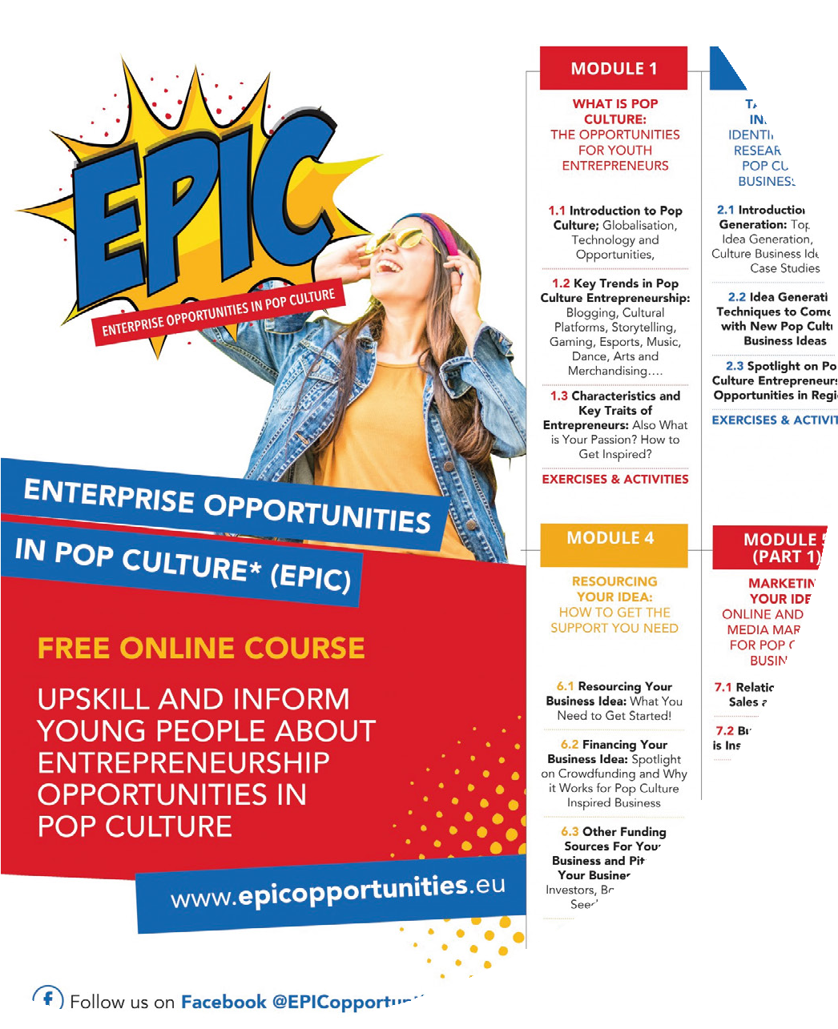
Pop Culture Educational Resources
Multimedia Resources
The EPIC OERs place Pop Culture at the center of an innovative and en- gaging approach to equip young people who are in NEETS (neither in education, training, or employment) with exciting entrepreneurial educa- tion, skills, tools, and support they need to develop a Pop Culture busi- ness.
https://www.epicopportunities.eu/curriculum-and-open-educational-resources/

Slide 16
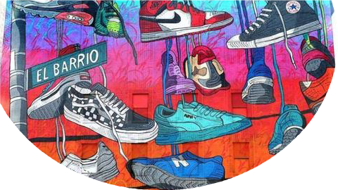
Multimedia Resources
Creative Marketing on a Shoestring Budget presented by Spectrum Business and SCORE
This in-depth webinar offers fresh ideas and insights to help you make the most of your marketing budget.
https://youtu.be/d_M5uRR3h88

Slide 17
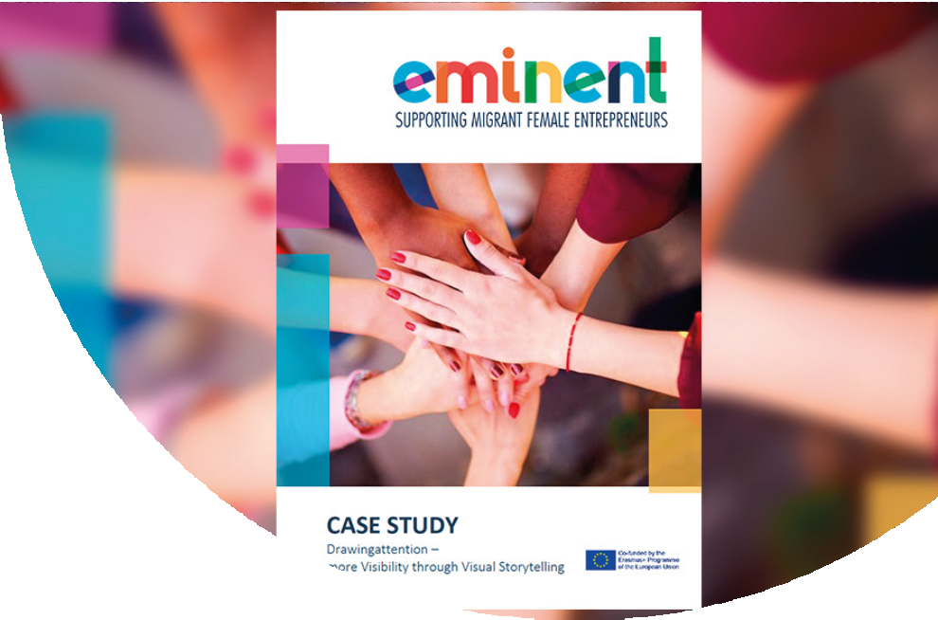
EMINENT Educa- tional Resources
Multimedia Resources
supporting migrant female entrepreneurs
This project aims to facilitate the increase of female migrant entrepreneurs by transforming their access to and the quality of the training they receive from entrepreneurship VET in- stitutions .
This course aims to improve access to and the quality of training for entrepreneurship educators within the context of inclusion and diversity, so as to unlock the potential of migrant & refugee women.
https://www.eminentproj- ect.eu/course-curricu-
lum-and-class- room-materials/

Slide 18
Communicate in your culinary project
Multimedia Resources
Here you will find a module about Communication used in another ERASMUS+ project with very good content and information to explore.
This module is available in English, French, German and Portuguese.
https://kuskusproject.eu/en/kus-kus-pro/communication/

Slide 19
Case Studies
for MODULE 5
Marketing your idea on a shoestring: brand development, word of mouth, social media and reputation marketing.

Slide 20
The Coca-Cola
Case Study 1
Coca-Cola Company has been listed as the world’s most valuable brand with 94% of the world’s population recognizing the red and white Coca-Cola brand Logo.
https://www.feedough.com/coca-cola-marketing-study/
Photo rights to Coca-cola

Slide 21
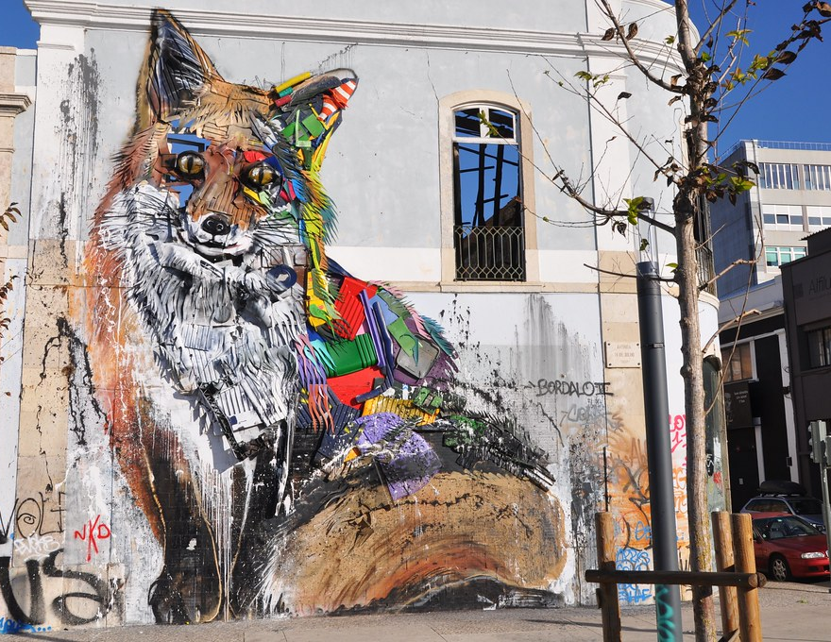
Bordalo II
Case Study 2
Bordalo uses “garbage” in the construction of small and large scale pieces that he has spread around the world and that, above all, intend to be the vehicle of a universal manifesto.
The use of a technic with a strong social impact, became the key feature to promote his work to the audience.
https://www.bordaloii.com

Slide 22
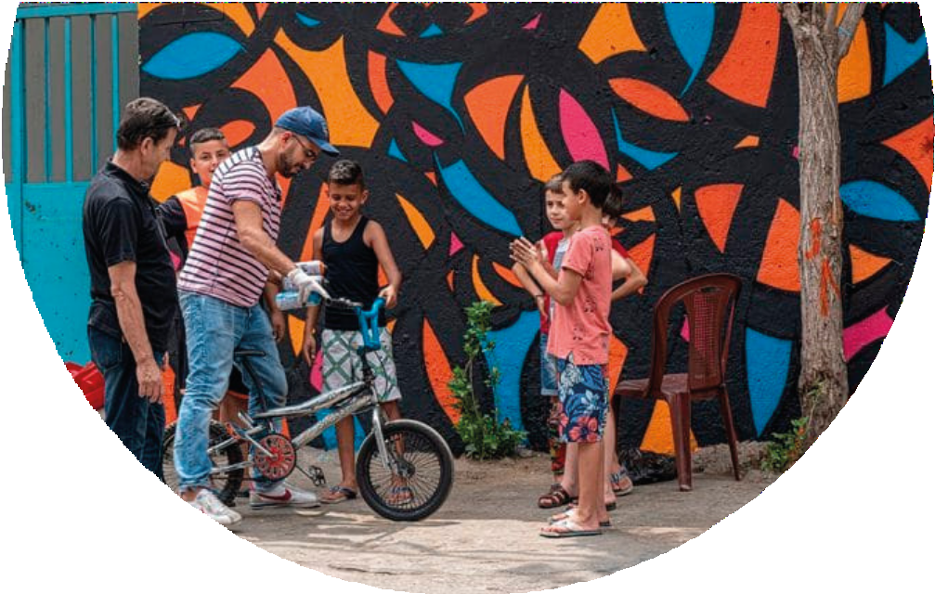
Case Study 3
Booking an
artist was never this easy
“Observing and talking to artists in the streets of Baixa and Chiado we realized two things: many artists are unbelievably talented, and at the same time overlooked and undervalued.”
BOOK A STREET ARTIST found what their clients were looking for and created a brand around it.
https://www.bookastreetartist.com

Slide 23
Learning Activities
for MODULE5
Marketing your idea on a shoestring: brand development, word of mouth, social media and reputation marketing.
Photo by Jason Goodman on Unsplash

Slide 24
1.The ‘Take-Over-The-World’ Game
Exercises
If you could create a content strategy and implementation, without thinking about barriers such as time and money, that would help your business an entire industry, what would that look like?
Games like this will open up your mind to explore
paths of thinking that you may not otherwise consider
under normal circumstances. These new
pathways of thought can lead to some
incredibly creative and innovative
content ideas.

Slide 25
Exercises
Define your Persona
Write down information about one type of customer/client that
your business has. You can do it by answering questions like the ones you see here.
A company can have multiple targets/personas, in which the marketing strategy will be different.
• How old are your typical
target market?
•Are they mostly female, mostly male or an even mix?
•Are they married or single? Do they have children?
•Where do they live? Where do they work?
•What ethnic groups predominate?
•What is the typical occupation and level of income?

Slide 26
Self - Assessment Exercise
for MODULE 5
Marketing your idea on a shoestring: brand development, word of mouth, social media and reputation marketing.

Slide 27
Self Assessment Tool for entrepreneurs
Self Evaluation
Here you will find an Entrepreneurship Assessment used in another ERASMUS+ project which had very good feedback for those deciding to explore Self-Employment.
You can try to fill it and share the results in classroom.

Slide 28
Thank You!
:)

Slide 29
https://www.street-culture.eu
www.facebook.com/streetcultureforregions
@streetcultureforregions
This project has been funded with support from the European Commission. The author is solely responsible for this publication (communication) and the Commission accepts no responsibility for any use may be made of the information contained therein. In compliance of the new GDPR framework, please note that the Partnership will only process your personal data in the sole interest and purpose of the project and without any prejudice to your rights.

