Slide 1
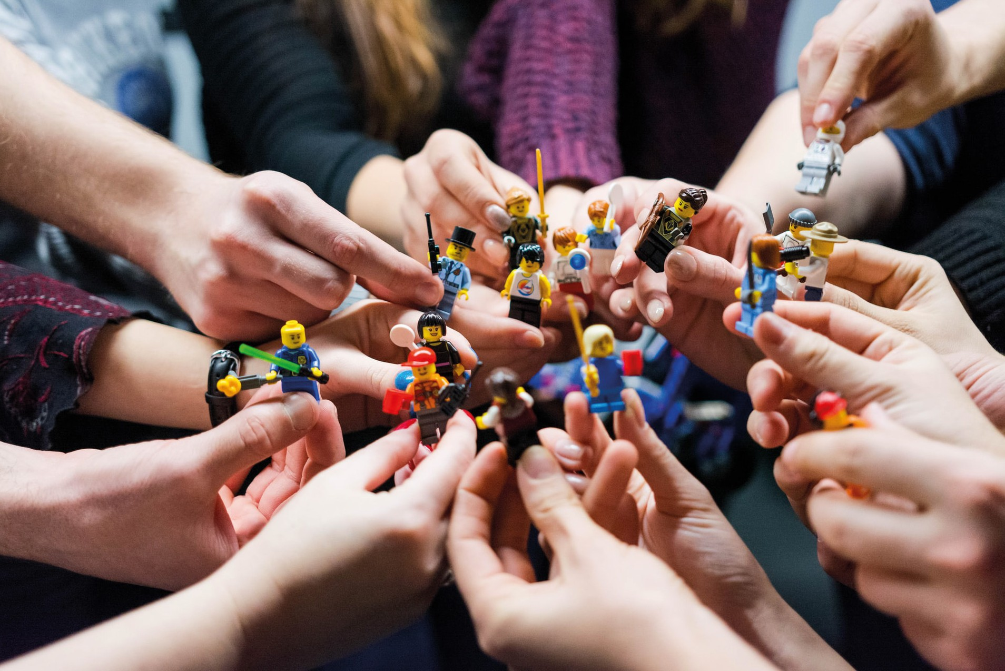
MODULE 6
Photo by Vlad Hilitanu on Unsplash
Evaluation: Learning & Improving your skills & performance over time
Collaboration for success
Street Culture Interconnections:
How to make them work
This project has been funded with support from the European Commission. The author is solely responsible for this publication (communication) and the Commission accepts no responsibility for any use may be made of the information contained therein. In compliance of the new GDPR framework, please note that the Partnership will only process your personal data in the sole interest and purpose of the project and without any prejudice to your rights.

Slide 2
Introduction
on Collaboration / Networking
for MODULE 6
Collaboration for success: Street Culture Interconnections how to make them work

Slide 3
Learning outcome
MODULE 6 focuses on the value of net- working and collaboration for the enter- prise benefits. It offers you a glimpse of the ways of collaboration help your busi- ness, tips and tools for networking and how to guarantee their success.
We have gathered a selection of sources reflecting on networking and fruitful col- laborations in street culture, and its rela- tion with successful entrepreneurship.
Completing this module...
will help you understand the power of networking and collabo- ration to address the needs of small enterprises and empower them to unlock opportunities for local economic development.

Slide 4
This set of modules allows you to develop the business/entrepreneurial skills and attributes to commercialise on your creative practices and/or knowledge on street culture.
The resources mentioned give you a theoretical and practical understanding of cultural and creative industries and the development of a cultural economy to create your own creative initiatives.
Our collective approach is to integrate entrepreneurship within creative practices relevant to street culture and to take a ‘creative’ approach to the devel- opment of new businesses and the infra- structure that supports them.

Slide 5
The Value of Collaboration
Photo by Guillaume Issaly on Unsplash
Collaborating with others can provide you with the additional skills and resources to do things. This could be anything from developing a new product or using new material in your design process, to securing a new client or gaining access to
significant funding.
The Power of Collaboration
and Networks - EMINENT PROJECT, p. 6
It is a WIN-WIN situation!
Collaboration Grows Your Network
Collaboration Saves Money
Collaboration is Problem-Solving
Collaboration as Mutual Advertising

Slide 6
Steps for a Succesfull Collaboration
Photo by Cem Ersozlu on Unsplash
Select collaborators - Enlist collaborators with little overlap with your fields of expertise.
Clarify roles & relationships - Avoid confusion or doubt about who has what role.
Set up clear communication paths - Communi- cation is central to collaboration.
Finding the mutual benefits that you may have through a collaboration is a
very imaginative and creative procedure!!!
The Power of Collaboration and Networks -
EMINENT PROJECT

Slide 7
Collaboration tools & platforms
1
2
TEDx Events - great for networking and meeting possible collaborators
Social Media e.g. Facebook Groups - use open groups to create an instant Cre- ative Community or why not have a pri- vate group for your Creative Collective
Entrepreneurship forums, conferences
- great way for making international con-
3
nections
Meet up (website/app) - great way of making connections and finding creative networking events/groups near you
4
Photo by Malu Laker on Unsplash
Free online social collaboration platforms - e.g. Diigo and Pinterest
5

Slide 8
Street Culture Networking
Photo by Rohan Reddy on Unsplash
Source: The Power of Collaboration and Networks -
EMINENT PROJECT
Networking will be very useful at the start of your business when you are less well connected.
Networking keeps you in touch with opportunities. You can turn to more people for help and advice.
Networking allows you to contribute something to others and build your reputation.

Slide 9
Types of business networks:
Photo by Jakob Owens on Unsplash
Source: The Power of Collaboration and Networks -
EMINENT PROJECT
1
Strong Networks (typically paid for net- works that focus on referral business in the network , e.g. BNI: Business Network Inter- national | Business Networking
2
Networking is an ef- fective low-cost method of increasing support to grow your business through re- ferrals and introduc- tions to develop op- portunities and con- tacts.
Casual networks - your attendance is optional – e.g. Chamber of Commerce net- working events in your area
3
4
Online networks - for advertising
Community service – e.g. TERN – Sup- porting refugees into business (weare- tern.org)
5
Professional Associations

Slide 10
Multimedia Resources
Module 6
Photo by Jason Goodman on Unsplash
Collaboration for success:
Street Culture Interconnections
- how to make them work

Slide 11
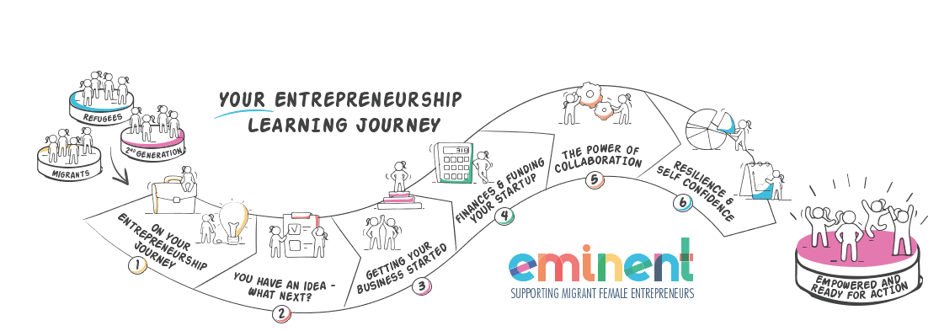
Multimedia Resources
EMIMENT project is a project that wants to enable Female Migrant Entrepreneurs. The trainees are provided the knowledge and skills they need to gain the confidence to establish and successfully run their own business. A special chapter (Chapter 5) is devoted to the power of collaboration and networks. www.eminentproject.eu

Slide 12
EMINENT
Educational Resources
Multimedia Resources
Few words about...
supporting migrant female entrepreneurs
This project aims to facilitate the in- crease of female migrant entrepreneurs by transforming their access to and the quality of the training they receive from entrepreneurship VET institutions.
https://www.eminentproject.eu/course-curriculum-and-classroom-materials/
This course aims to improve the quality of training for entrepreneurship educators within the context of inclusion and diversity , so as to unlock the potential of migrant & refugee women.

Slide 13
Many of the ways we talk about creative work only capture the brilliance of a single individual. But cre- ativity also thrives on diversity, tension, sharing, and collaboration. Two (or more) creative people can leverage these benefits if they play well together.
Multimedia Resources
Creative collaboration:
Everything you need to know
about successful collaboration for creative
teams
This in-depth research article presents ways to collaborate in creative business.
https://gathercontent.com/blog/how-to-collaborate-the-creative-the-practical

Slide 14
Tools for happy communi- cation and collaboration to ensure smooth-running projects
Multimedia Resources
Photo by Quaid Lagan on Unsplash
A study and plan on favorite apps, tools and software for working to- gether as creatives in 2022:
•project management tools
•videoconferencing tools
•messaging tools
•feedback tools
https://www.creativeboom.com/resources/tools-for-happy-communication-and-collaboration/

Slide 15
Collaborative Creative Advertising
Multimedia Resources
Strategic brand collaborations, or partnerships, can be an extraordinarily effective way to build your business. These partnerships allow brands to enter new markets more confidently and increase brand awareness in a more efficient way. They are also a way for brands to amplify their appeal by becoming part of a whole that is greater than the sum of its parts.
https://dynamicbusiness.com/topics/small-business-resources/sales-and-marketing/the-power-of-strategic-brand-collaboration.html

Slide 16
Case Studies
MODULE 6
Collaboration for success: Street Culture Interconnec- tions - how to make them work

Slide 17
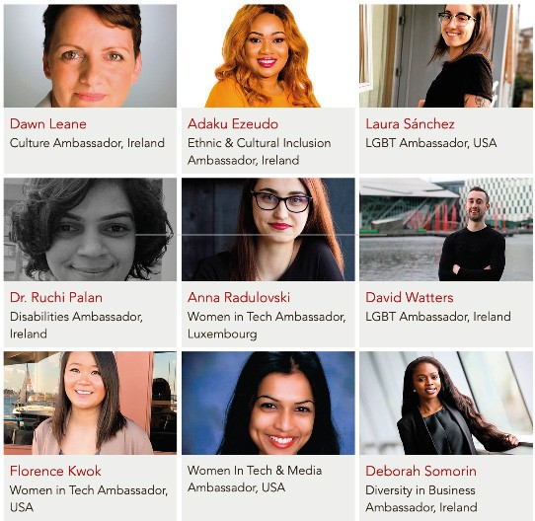
MIGRANT WOMEN LEADING ENTREPRENEURSHIP
Case Study 1
Furkan Karayel: She collaborates with all these ambassadors to deliv- er a wider scope of services.
https://www.diversein.com/copy-of-about
Source: The Power of Collaboration and Networks -
EMINENT PROJECT

Slide 18
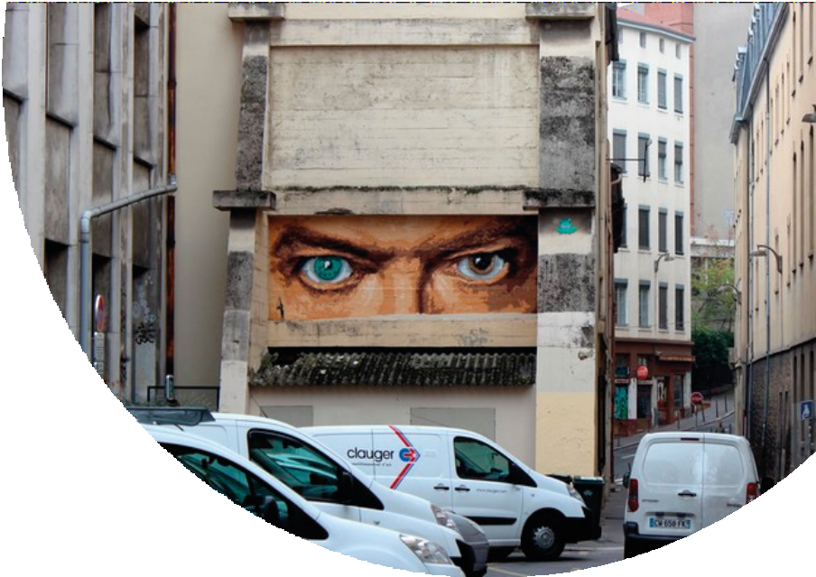
The Street Art Network
Case Study 2
The example of the Street Art Network educates, inspires, and connects people with street art through mural commis- sions, resources for artists, and documen- tation and preservation efforts.
It operates with the belief that public art has the power to unite and inspire com- munities in ways that indoor art simply cannot duplicate. Its mission is to support the creative entrepreneurs who take to the streets with their art while giving them a platform to collaborate, network, fund projects and spread their message.
www.thestreetartnetwork.com
Photo by Big Ben, street artist

Slide 19
A LIST OF CREATIVE EUROPE NETWORKS
Making the Voices of Culture stronger and more impactful
Case Study 3
The Creative Europe Programme currently supports key European Cultural Networks. They clearly show the variety and vibrancy of Europe’s cultural operators and
stakeholders.
https://www.europecreative.be/images/culture/Pdfs/Publications/Creative_Europe_Networks_2018.pdf
Photo by Providence Doucet on Unsplash

Slide 20
Learning Activities
for MODULE 6
Evaluation: Learning & Improving your skills & performance over time
Photo by Jason Goodman on Unsplash

Slide 21
Here are the 9 collaborator
Exersices
Exersices
TYPES OF COLLABORATORS WHICH ONE DO YOU THINK YOU MIGHT BE?
types to choose from:
The Ringleader The Stealth Ninja
The Expert The Executive The Socialite The Siloist The Skeptic The Dinosaur
The Taskmaster
Source: https://imeetcentral.com/downloads/download-9-types-collaborators-infographic

Slide 22
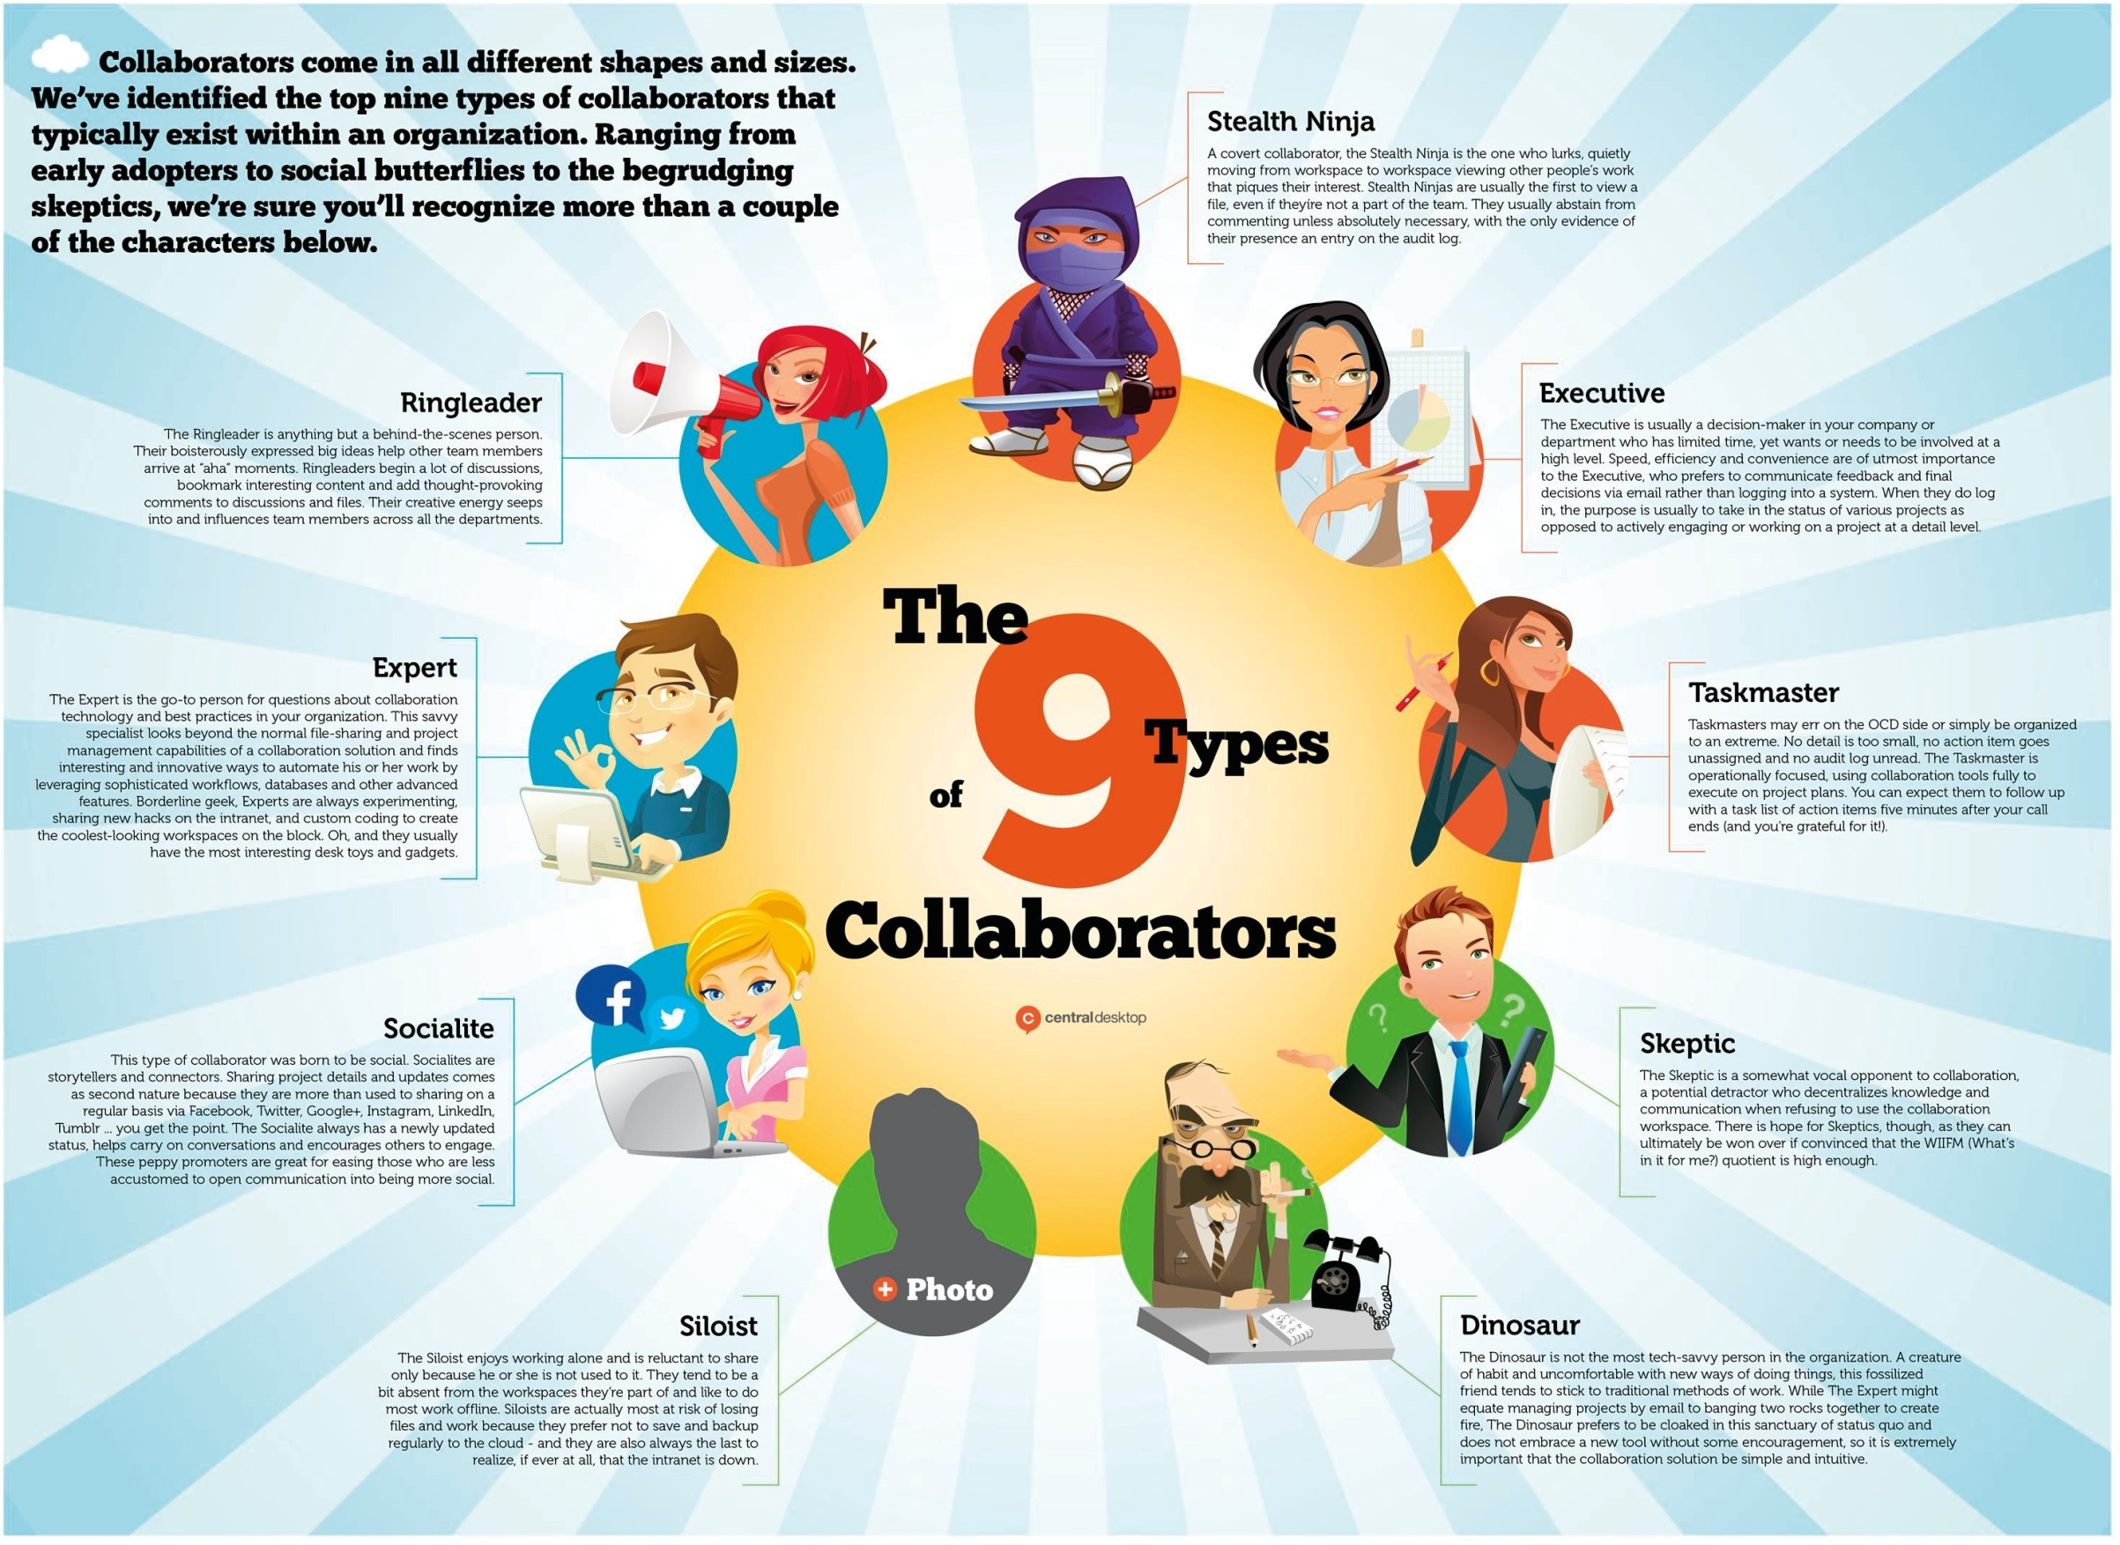

Slide 23
Make a list of Networks
Exersices
Research the networking platforms that you can access in your:
Area/region
Sector
Online specific that are relevant to your business

Slide 24
Self - Assessment & Evaluation
for MODULE 6
Evaluation: Learning & Improving your skills & performance over time

Slide 25
TIPS
Self Evaluation
Clear vision of where you want to go.
Prioritising what’s important.
Delegating. Learn new skills.
What is success for you?
DID YOU KNOW THERE ARE 10 TYPES OF SUCCESS?
• MATERIAL SUCCESS – Money,
cars, holidays, jewelry
• EMOTIONAL SUCCESS – Rela-
tionships, self-esteem, contentment
• INTELLECTUAL SUCCESS – Learning, understanding, challenging
• SPIRITUAL SUCCESS – Sense of
purpose, belonging, reason
• PHYSICAL SUCCESS – Health,
fitness, vitality, appearance

Slide 26
DEFINING SUCCESS ON YOUR OWN TERMS
Self Evaluation
• COMMERCIAL SUCCESS – Enter-
prise growth, profit, reputation
• EVANGELICAL SUCCESS – Influencing others, promoting your ideals
• ENVIRONMENTAL SUCCESS –
Home, garden, saving the planet
• TIME SUCCESS – Longevity, time management
• COLLECTIVE SUCCESS – The product of effective teamwork
Source: The Power of Collaboration and Networks -
EMINENT PROJECT

Slide 27
SUCCESS:
WHAT DOES IT LOOK LIKE?
Self Evaluation Exercise
While this is best completed as a Group Exercise, it can also be used as an individu- al reflection exercise.
Materials Needed: a selection of random images to include people, build- ings, objects, cars etc.
Exercise findings: This exercise may lead you to challenge tradi- tional views on success. It shows that success has many different meanings to different people. It will also introduce the idea of there being different types of success.
Choose 3 images that you feel represent success. Write down the main points that you think they represent success.
If this is a group exercise, each group shows their photos in turn and explains why they think it represents success.

Slide 28
GOALS:
Self Evaluation
SETTING REALISTIC & ACHIEVABLE “SMART” GOALS
Specific. Goals need to be very clear and as detailed as possible.
Measurable. Goals need to be tangible; re- sults need to be measurable. Ask yourself questions like: “When?” and “How much?”
Action-oriented. Make sure you can identify the steps you need to take to reach each goal.
Relevant. Here’s where you need to think about the big picture. Why are you setting the goal that you’re setting?
Source: https://www.atlassian.com/blog/productivity/how-to-write-smart-goals
Time-bound. What’s your time horizon?

Slide 29
Thank You!
:)

Slide 30
https://www.street-culture.eu
www.facebook.com/streetcultureforregions
@streetcultureforregions
This project has been funded with support from the European Commission. The author is solely responsible for this publication (communication) and the Commission accepts no responsibility for any use may be made of the information contained therein. In compliance of the new GDPR framework, please note that the Partnership will only process your personal data in the sole interest and purpose of the project and without any prejudice to your rights.

